Slide 1
The PRAM Metamodel and Compilation of Domain Models
Paul Cohen, Tomek Loboda, Ashish Jha
May 15, 2019

Slide 2
Goals
One metamodel that unifies several common modeling and inference frameworks
Semi-automated construction of domain models facilitated by metamodel

Slide 3
PRAM
Graphical models, ABMs, ODE models, compartmental models
factorizations, conditional independence, feature selection...
static analysis
semi-automated compilation
sampling, parameter estimation,
Executable models
dynamics, convergence, emergent properties...
dynamic analysis
Notes:
The first part of this briefing will focus on the PRAM metamodel of redistribution and how probabilistic graphical models, ABMs, ODE models and compartmental models are instances of PRAM models (prams). The second part will focus on the possibility of compiling models semi-automatically given specifications at the meta-model layer.
Note that the analogy to compilers is very strong, in that common compiler operations such as static and dynamic analysis already are implemented in PRAM.

Slide 4
Domain Ontology
domain variables, aggregators
(e.g., domain metrics) , rules
?
Problem
How is "mass" redistributed, e.g., dynamics of groups changing in size; dynamics of ordinary people becoming radicalized; dynamics of wealth distribution; dynamics of ebola outbreaks.
Pitt/PRAM
Rules specify how mass is dynamically redistributed
Formulation(s)
Groups, aggregators, rules are primitives of simple PRAM programming language
Modeling framework(s)
choice
Model(s)
PRAM models have interpretations as ABMs, Bayesian networks, ODE models etc
Implementation library(ies)
choice
Rules and aggregator syntax plus relational databases semi-automatically yield executable PRAM simulation models
Executable code(s)
PRAM compiler produces executables of nondeterministic redistribution over groups, which is equivalent to ABMs, DBNs, and other common forwarfd inference methods
Computation & execution constraints
Results

Slide 5
Galois, Asimov, Pitt
These projects have users interacting with modeling at the abstract level and use intermediate structured representations that are strictly implicit.
User can create new models and instantiate them in executable forms in various modeling frameworks.
Galois and Asimov use visual languages for model composition and prototype includes significant HMI progress.
Asimov approach likely highly specialized to genetic circuit design but hopefully there are still general lessons to be learned.
Pitt approach is specific to models amenable to probabilistic, ABM, and/or ODE type implementations, with a more abstract implementation unifying.
Galois approach is generic and visual but requires specific sets of primitives and grammars be defined for each domain.
?

Slide 6
PRAM metamodel and inference: Informal
PRAM models (prams) assign "mass" to "configurations" and PRAM inference is rule-based redistribution of mass over configurations conserving total mass
prams are intended to elicit the dynamics of mass over configurations
people getting sick, infecting others, and then recovering
people entering the workforce, moving among sectors, retiring
molecules binding, changing the concentrations of species
We think PRAM models can be transformed into agent-based, compartmental, probabilistic graphical and ODE models.

Slide 7
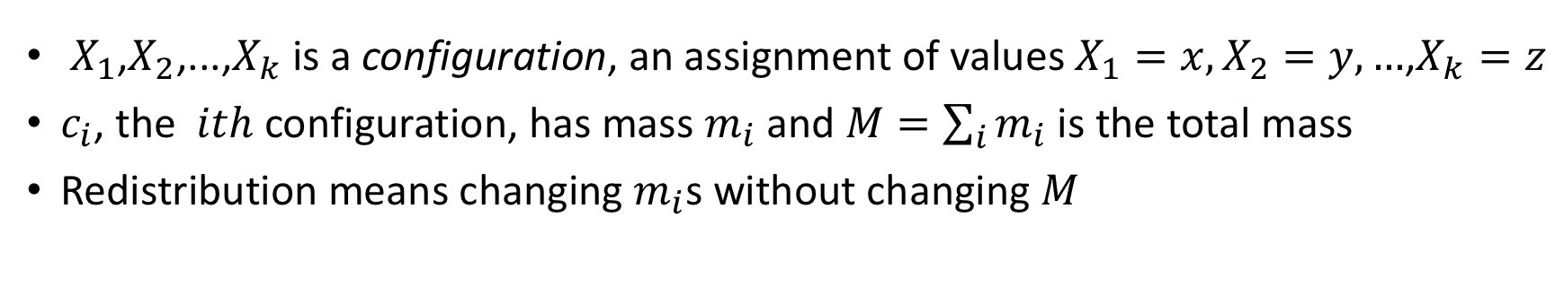
PRAM metamodel and inference: More formal
$X_{1}$,$X_{2}$,...,$X_{k}$ is a configuration, an assignment of values $X_{1}=x,X_{2}=y,…$,$X_{k}=z$
$c_{i}$, the $ith$ configuration, has mass $m_{i}$ and $M=\sum_{i}{m_{i}}$ is the total mass
Redistribution means changing $m_{i}$s without changing $M$
 | X₁ = S | X₁ = I | X₁ = R
X₂ = L | LS | LI | LR
X₂ = M | MS | MI | MR
configurations
 | X₁ = S | X₁ = I | X₁ = R
X₂ = L | m(LS) | m(LI) | m(LR) | m(L•)
X₂ = M | m(MS) | m(MI) | m(MR) | m(M•)
 | m(•S) | m(•I) | m(•R) | M
masses and redistribution
e.g., LS sends mass to LI
Notes:
We begin with the familiar formulation of assignments to random variables, called configurations. Then we add the notion of mass assigned to a configuration. For example, the configuration LS (low income, susceptible) has mass m(LS). We add rules that redistribute mass probabilistically; for example, LS -> LI with probability p means that LI gains mass p(m(LS)).
Remarkably, this is almost everything we need to 1) formulate a wide variety of redistribution problems, 2) reformulate these problems as ABMs, bayesian inference, etc.

Slide 8
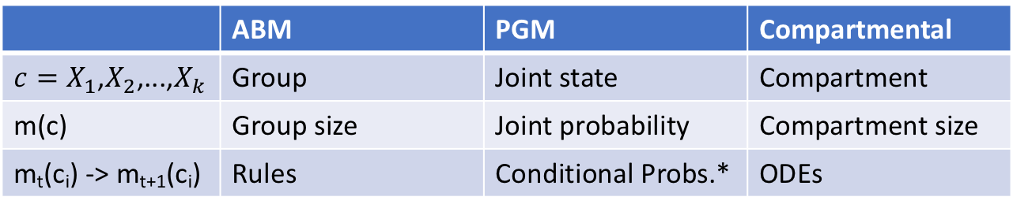
One metamodel, several model types
 | ABM | PGM | Compartmental
${c=X}_{1}$,$X_{2}$,...,$X_{k}$ | Group | Joint state | Compartment
m(c) | Group size | Joint probability | Compartment size
m_{t}(c_{i}) -> m_{t+1}(c_{i}) | Rules | Conditional Probs.* | ODEs
*However, CPTs change from one iteration to the next
 | X₁ = S | X₁ = I | X₁ = R
X₂ = L | m(LS) | m(LI) | m(LR) | m(L•)
X₂ = M | m(MS) | m(MI) | m(MR) | m(M•)
 | m(•S) | m(•I) | m(•R) | M
masses and redistribution
e.g., LS sends mass to LI
Notes:
You can get the general idea of how prams are interpreted as different kinds of models by reviewing the first table. However, prams are not straightforwardly Bayesian models: While obviously we can get conditional probabilities from joint and marginal probabilities, if you turn a pram into a dynamic Bayes' net then the conditional probability tables change at every iteration, which seems to be a new kind of model.

Slide 9
PRAM
Graphical models, ABMs, ODE models, compartmental models
factorizations, conditional independence, feature selection...
static analysis
semi-automated compilation
sampling, parameter estimation,
Executable models
dynamics, convergence, emergent properties...
dynamic analysis
Notes:
Let's briefly consider how PRAM compiles down to executable models. The basic idea is that rules and aggregators (described on the next slide) are sufficient for PRAM to build executables by reading from databases. This has been implemented for both prams->ABMs and for prams->Dynamic Bayesian Networks, though not all prams can be compiled to DBNs.

Slide 10
PRAM building blocks: Groups, relations, aggregators, rules
Groups (aka configurations, c): LS, LI, ..., MR
Relations: LS,rA means group LS has relation r with A
Group sizes (aka m(c)): m(LS), m(LI), ..., m(MR)
Aggregators (functions over groups): infectProb(Y) = m(•I,rY)/(m(••,rY))
Rules: m_{t+1}(LI) = m_{t}(LI) + InfectProbL x m_{t}(LS) ; #new infections is proportional to fraction infected
m_{t+1}(LI,rH) = p(m_{t}(LI,rA)), m_{t+1}(MI,rH) = q(m_{t}(MI,rA)) # low-income stay home w probability p
# middle income with probability q
 | X₁ = S | X₁ = I | X₁ = R
X₂ = L | m(LS,rA) | m(LI,rA) | m(LR,rA) | m(L,rA•)
X₂ = M | m(MS,rA) | m(MI,rA) | m(MR,rA) | m(M,rA•)
X₂ = L | m(LS,rB) | m(LI,rB) | m(LR,rB) | m(L,rB•)
X₂ = M | m(MS,rB) | m(MI,rB) | m(MR,rB) | m(M,rB•)
X₂ = L | m(LS,rH) | m(LI,rH) | m(LR,rH) | m(L,rH•)
X₂ = M | m(MS,rH) | m(MI,rH) | m(MR,rH) | m(M,rH•)
 | m(•S) | m(•I) | m(•R) | M
aggregator for school A
aggregator for school B
aggregator for home
Notes:
A word about aggregators: Suppose you are interested in the interaction of an epidemic (e.g., modeled by SIR) and income, and you also want to consider two different high schools and whether or not students stay home. If the probability of getting sick at school A or B depends on the proportion of sick students at school as opposed to staying home, then you need a way to calculate the proportion of sick kids at a location.
Suppose R(g,s) is a relation between a group g and a site s; for example at(g,A) says g is at A. Aggregators are functions over groups that stand in relations to sites. For example; we can get the proportion of all students who are sick at a school A by iterating over groups g such that at(g,A).

Slide 11
Semi-autonomous Construction of prams
It starts with rules and aggregators (which at present humans write)
m_{t+1}(LI) = m_{t}(LI) + InfectProbL x m_{t}(LS) # Infected "mass" is uninfected mass x infection probability
m_{t+1}(LI,rH) = p(m_{t}(LI,rA)) # low-income infected (LI) stay home with probability p and
# stay at A with probability 1-p
m_{t+1}(MI,rH) = q(m_{t}(MI,rA)) # middle-income infected (MI) stay at home with probability q
Rules like these tell PRAM to form groups based on income level, flu status, and relation r to locations
PRAM does this semi-automatically by reading databases
Given rules, PRAM builds simulation models with almost no human intervention
Notes:
Rules and aggregators tell PRAM which information to gather about a population. The rules and aggregators in the example here tell PRAM that we care about income level, flu status and relations to locations. We might have much more information about students in various databases, but PRAM doesn't build more groups than it needs to run its rules. So the only groups it will build are those that have different configurations of income level, flu status and relations to locations.
PRAM analyzes its rules, reads databases (e.g., the database of Allegheny County students) and automatically builds groups from the data in the databases.

Slide 12
Status
One metamodel that unifies several common modeling and inference frameworks
PRAM is a metamodel that seems to unify common frameworks, but we haven't proved it, yet.
Semi-automated construction of domain models facilitated by metamodel
PRAM-based domain models can be constructed semi-automatically

Slide 13
Backup slides

Slide 14
PRAM building blocks: Groups, aggregators and rules
Mass M is distributed among groups. Aggregators compute functions over groups. Rules, conditioned on aggregators, create and merge groups, redistributing M.
Aggregators
Groups
Rules
Notes:
The only building blocks are groups, which have mass, and attributes (as described later); and aggregators over groups, which compute functions over groups; and rules, which decribe how the masses of groups change, conditioned on aggregators and group attributes. Inference in PRAM is called redistribution, and all it does is change the sizes of groups; for example, by the applicationif rules, the blue group gets bigger, the green group gets smaller, the brown group, which didn't previously exist, grows, and the tan group shrinks. Surprisingly, with these simple building blocks, PRAMS can become agent-based models, compartmental models, Bayesian belief models, and probably other things.

Slide 15
The PRAM Engine Redistributes the Counts of Groups
Suppose we have just two groups, g1 and g2 with counts c1 and c2 and one feature, which takes values s, e, and r. Suppose we have one rule:
If f == s
then P(f==e) = p and P(f==s) = 1 - p
f == e
then P(f==r) = q and P(f==e) = 1 - q
On the first iteration, PRAM splits g1 into two potential groups of sizes p*c1 and (1-p)*c1 and splits g2 into potential groups of sizes q*c2 and (1-q)*c2. Each potential group is then merged with an extant group or creates a new group. The resulting groups are:
g1 with count (1-p)*c1
g2 with count (1-q)*c2 + p*c1
g2_1 with count q*c2

Slide 16
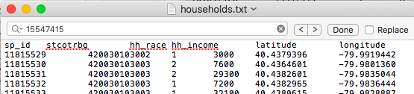
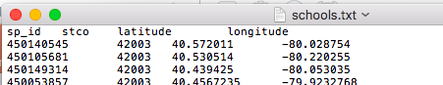
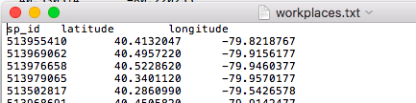
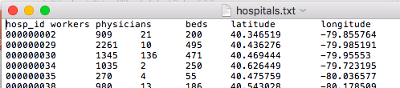
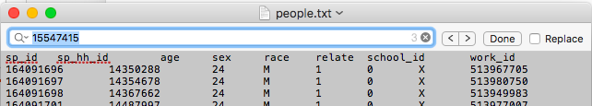
Suppose you wanted to quickly build a PRAM for Allegheny County
sites
groups
A machine could read these tables and build one agent per person and one site per school, household, hospital or workplace. However, for good reasons, PRAM works with groups, not individuals.

